Slide 1


Generative Adversarial Neural Networks
Redes Neurais e Deep Learning - Prof. Renato Souza
Aldo Galeano

Slide 2
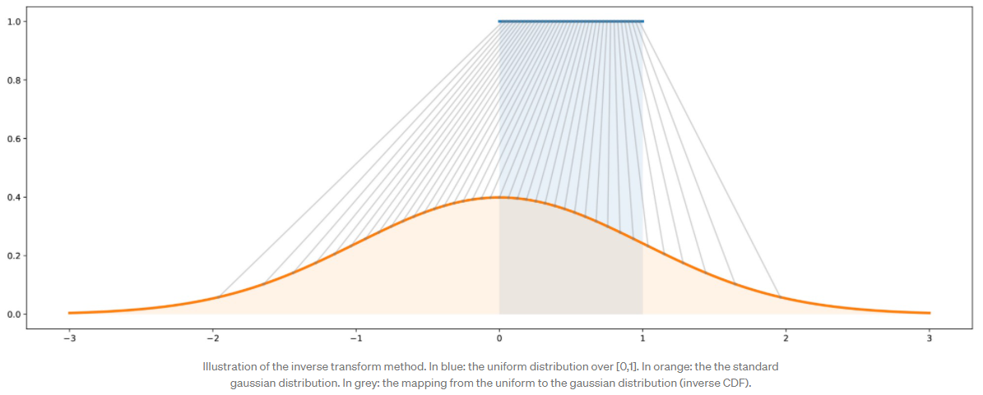
What is a Generative Model?
A Generative Model should be capable of generating a complex random variable from a simple one.

Slide 3
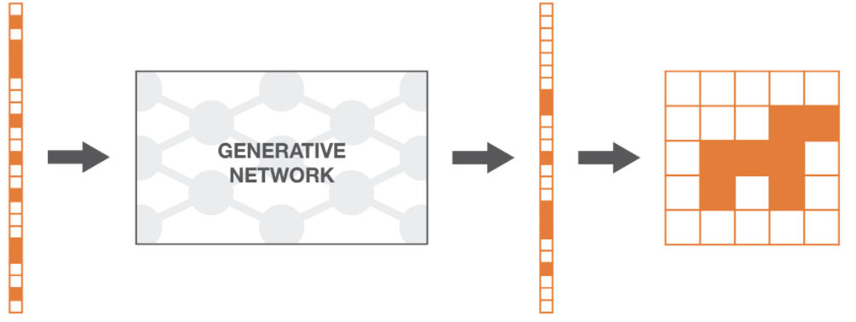
What is a Generative Model?
It is assumed that real data are instances of a probabilistic distribution.

Slide 4
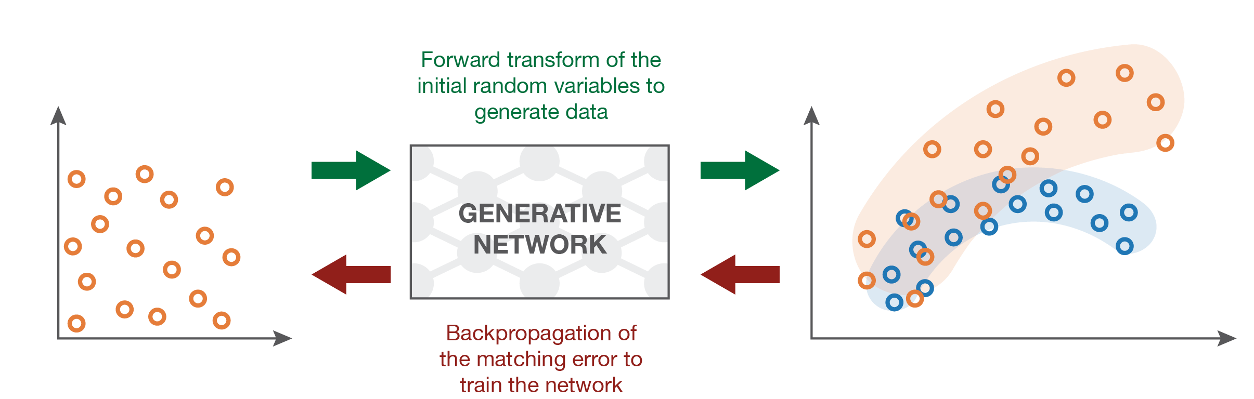
What is a Generative Model?
The objective is to learn such distribution to be able to generate artificial data.

Slide 5
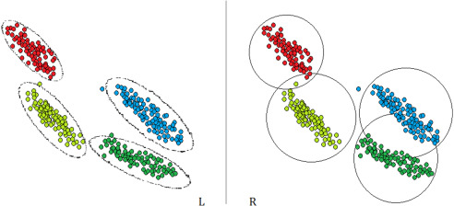
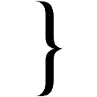
Generative Models
Gaussian Mixture Models.
Latent Dirichlet Allocation.
Hidden Markov Models.
Restrict Boltzmann Machines.
Deep Belief Networks.
Deep Boltzmann Machines.
Variational Autoencoders.
Generative Adversarial Networks.
Deep Learning Based

Slide 6
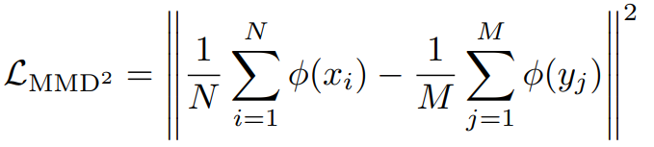
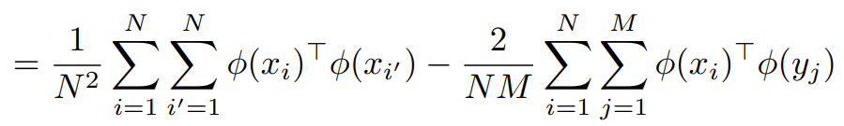
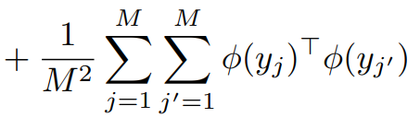
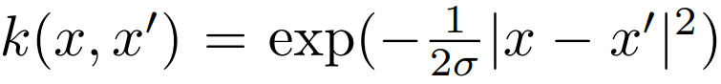
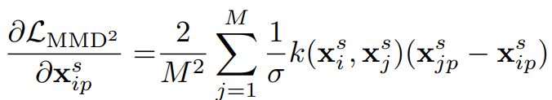
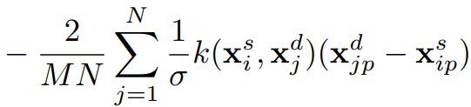
Generative Moment Matching Networks
The key idea: Maximum Mean Discrepancy

Slide 7
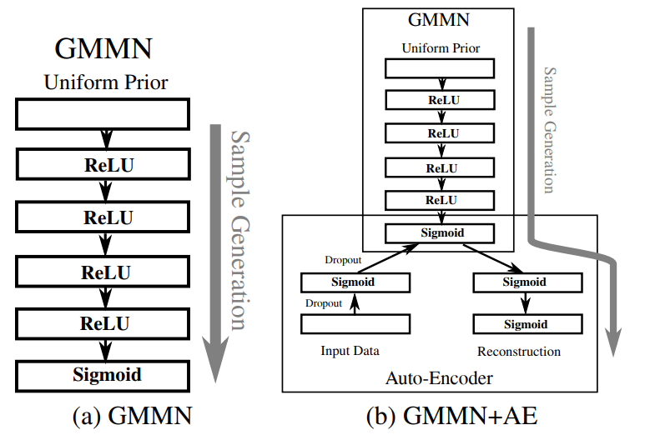
Generative Moment Matching Networks

Slide 8
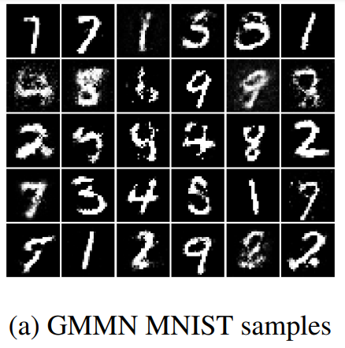
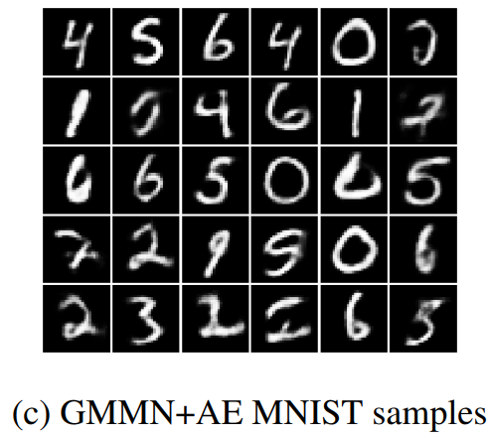
Generative Moment Matching Networks

Slide 9
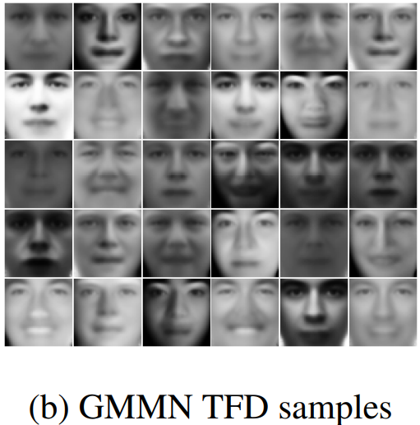
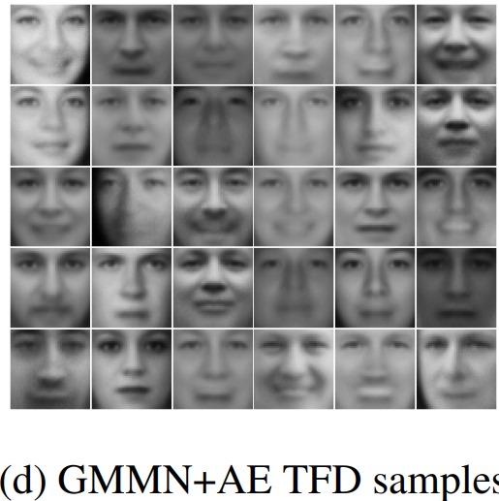
Generative Moment Matching Networks

Slide 10
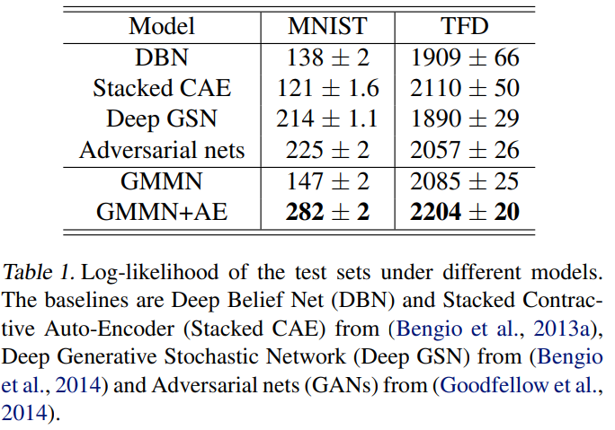
Generative Moment Matching Networks
For evaluation: A Gaussian Parzen Window was fit with samples generated from the model, the likelihood of the data was estimated under this distribution.

Slide 11
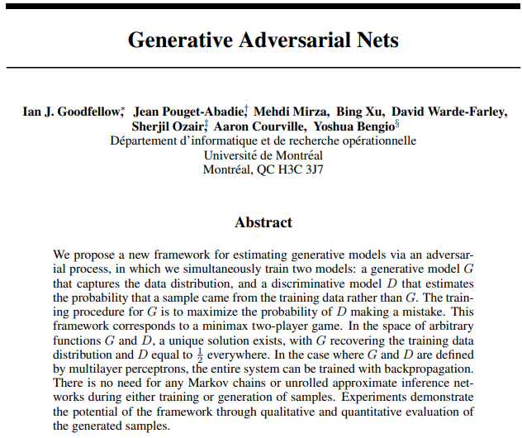
Generative Adversarial Neural Networks

Slide 12
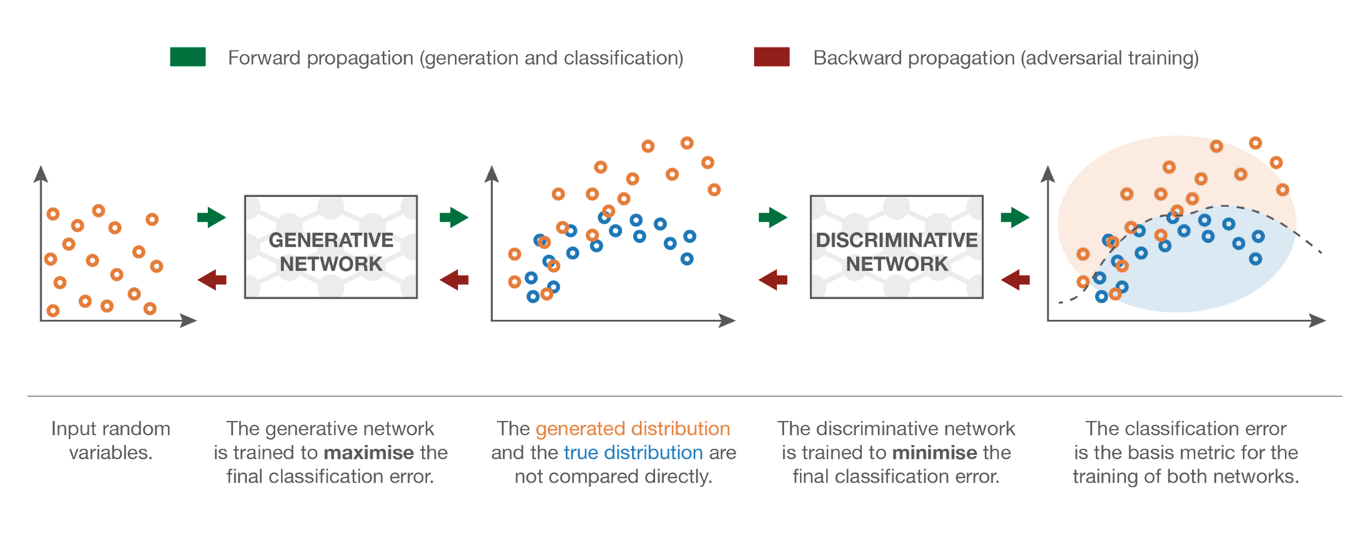
Generative Adversarial Neural Networks

Slide 13
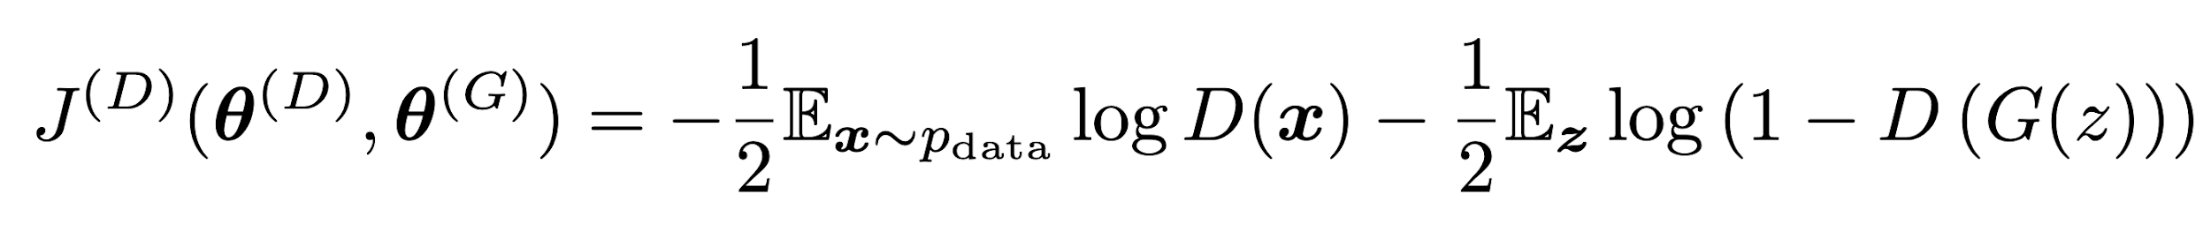
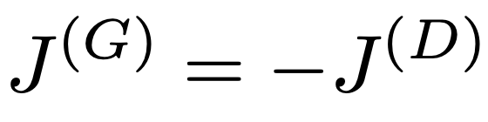
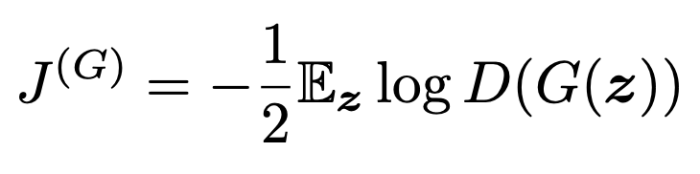
Generative Adversarial Neural Networks
Discriminator
Generator
(theoretical)
(an implementation tip)

Slide 14
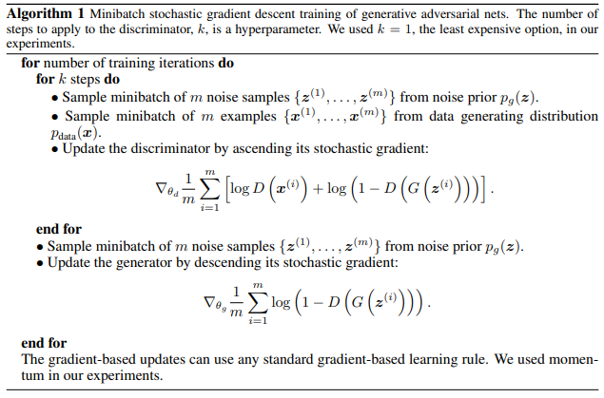
Generative Adversarial Neural Networks

Slide 15
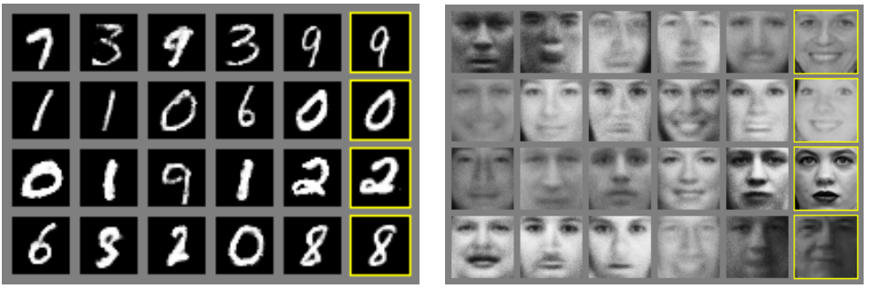
Generative Adversarial Neural Networks

Slide 16
GANs Applications:
Learn conditionals probability distribution.

Slide 17
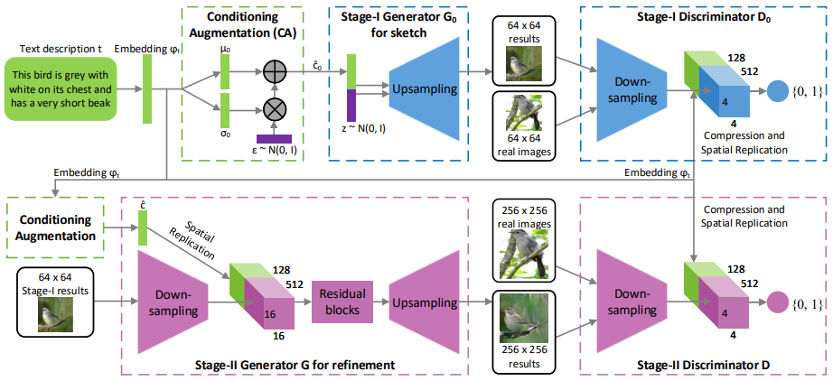
GANs Applications: Text to Image
StackGAN: Text to Photo-realistic Image Synthesis with Stacked Generative Adversarial Networks.

Slide 18
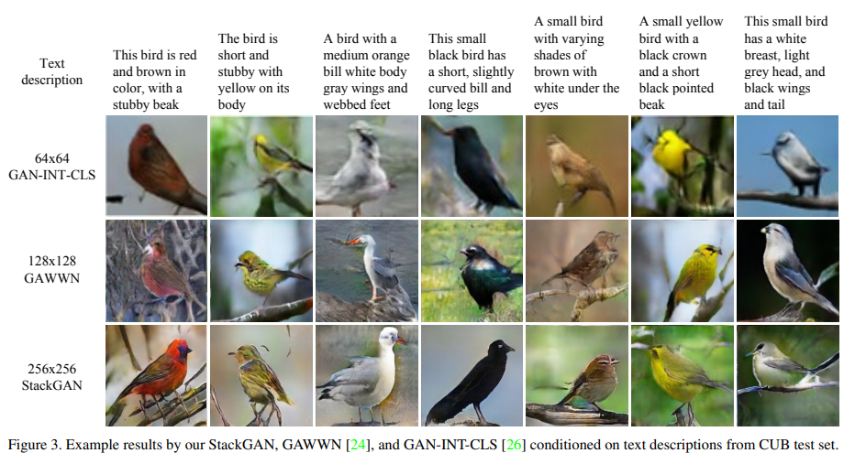
GANs Applications: Text to Image

Slide 19
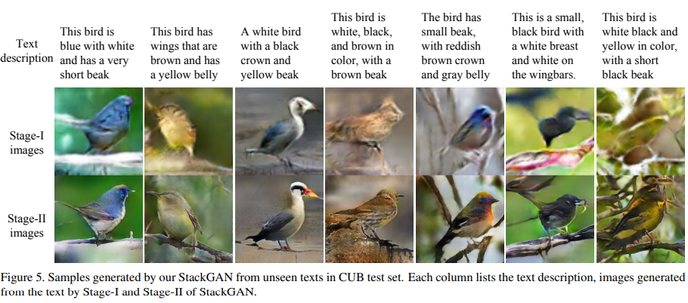
GANs Applications: Text to Image

Slide 20
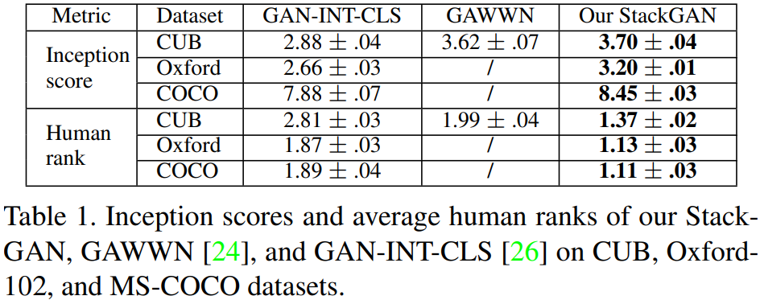
GANs Applications: Text to Image
StackGAN: Text to Photo-realistic Image Synthesis with Stacked Generative Adversarial Networks.

Slide 21
GANs Applications:
real_data_1
.
.
real_data_n
a_data_1
.
.
a_data_m
Data Augmentation to improve the performance of other ML models.
real_data_1
.
.
real_data_n

Slide 22
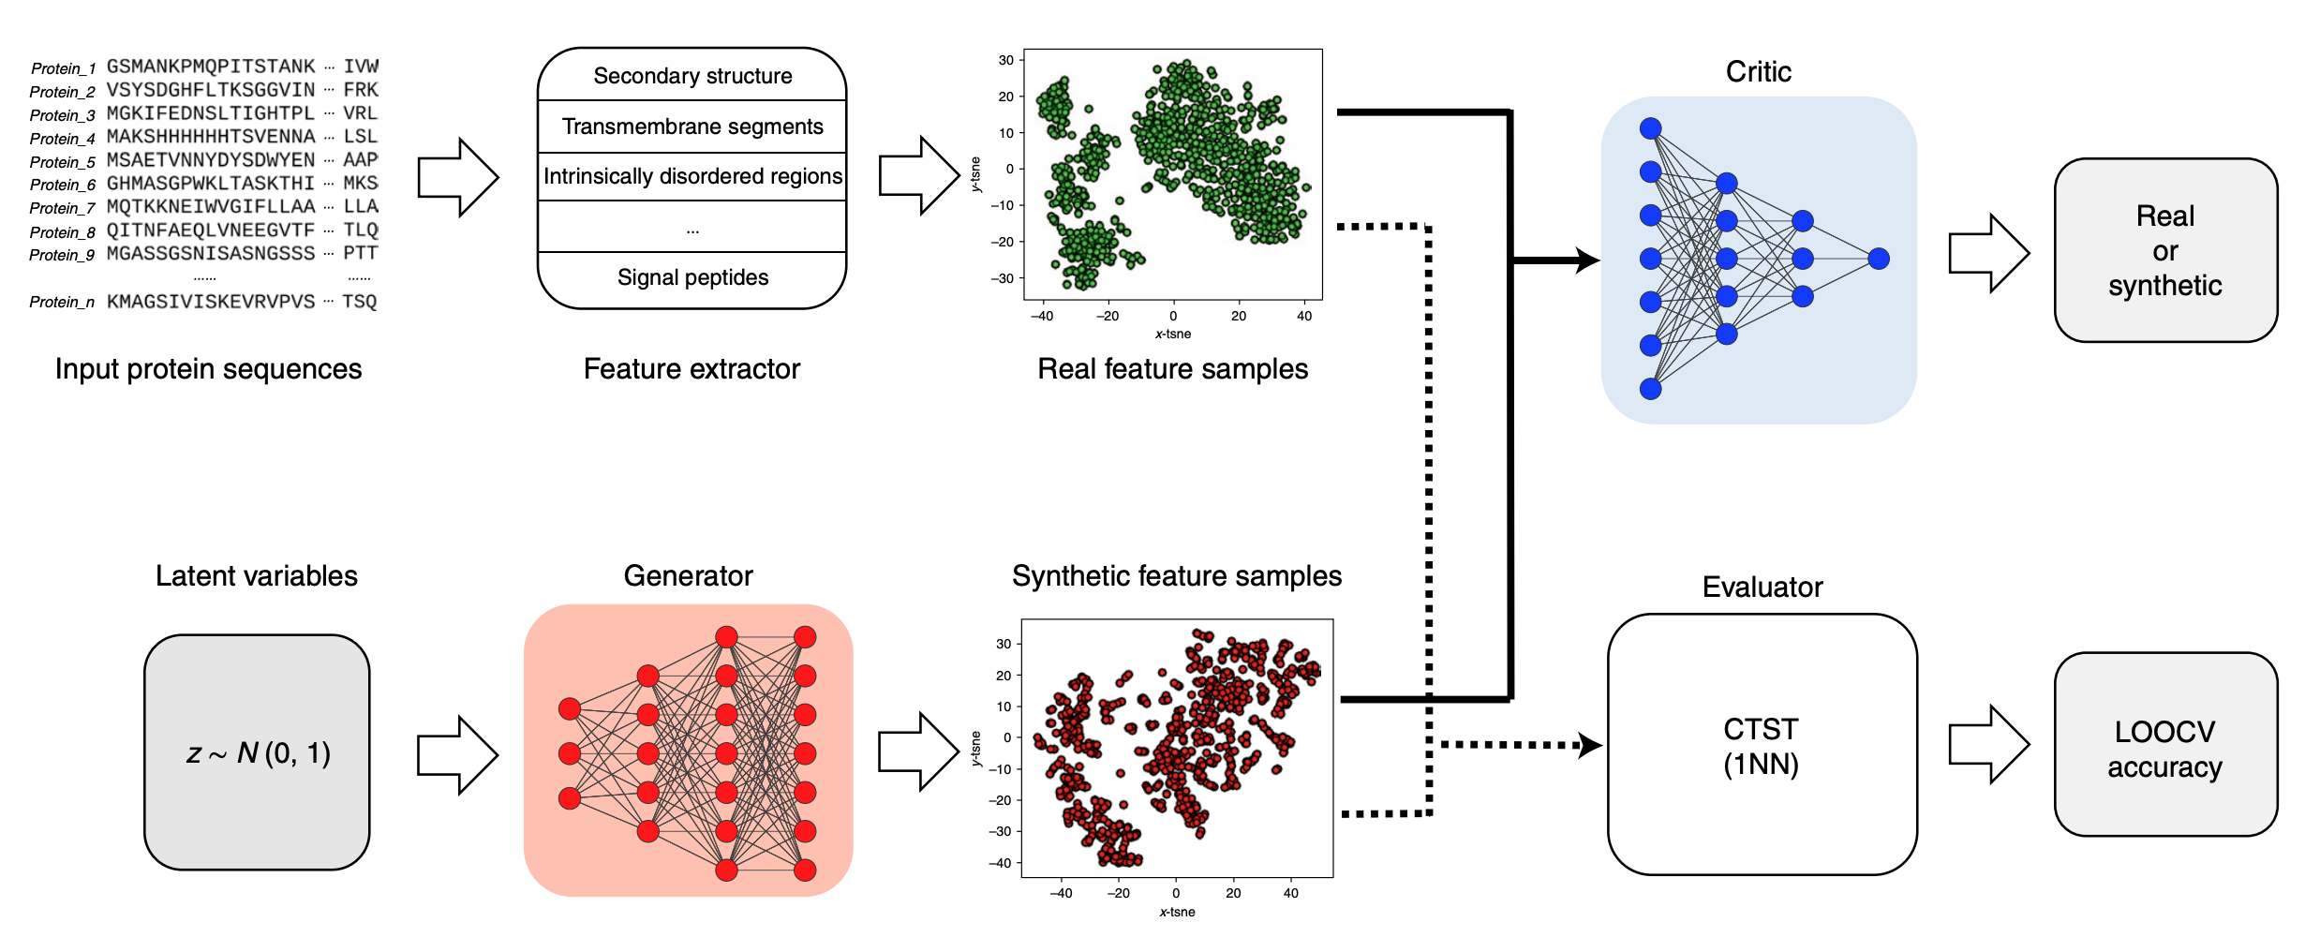
GANs Applications: Data Augmentation
Protein Function Prediction is improve by creating synthetic features samples with generative adversarial networks.

Slide 23
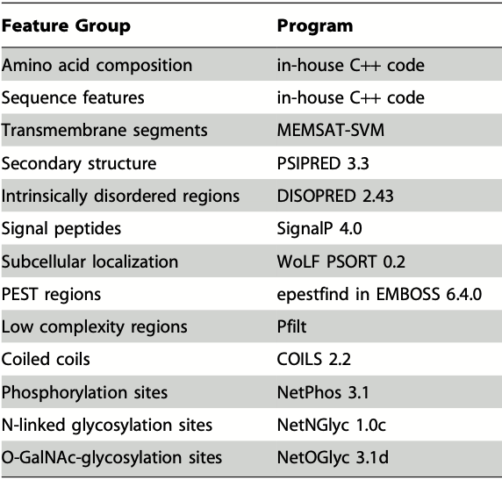
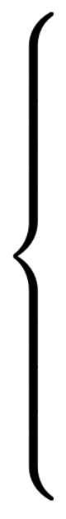
GANs Applications: Data Augmentation
258 features

Slide 24
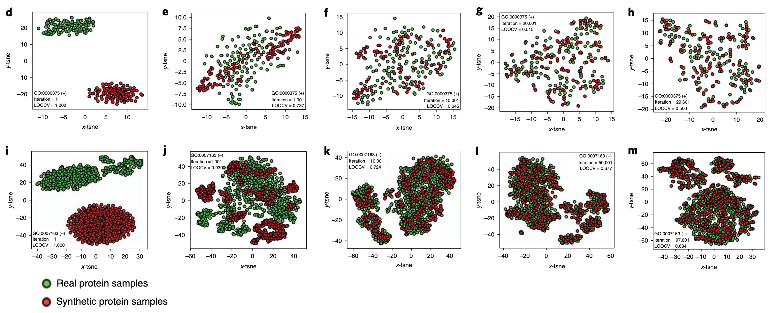
GANs Applications: Data Augmentation
Protein Function Prediction is improve by creating synthetic features samples with generative adversarial networks.

Slide 25
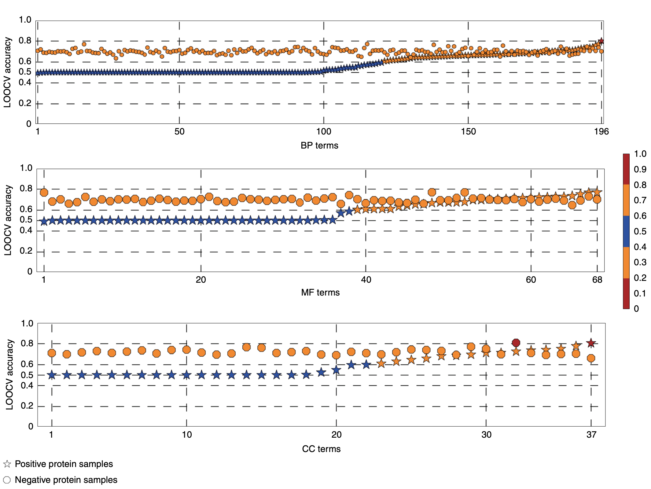
GANs Applications: Data Augmentation
Evaluation:

Slide 26
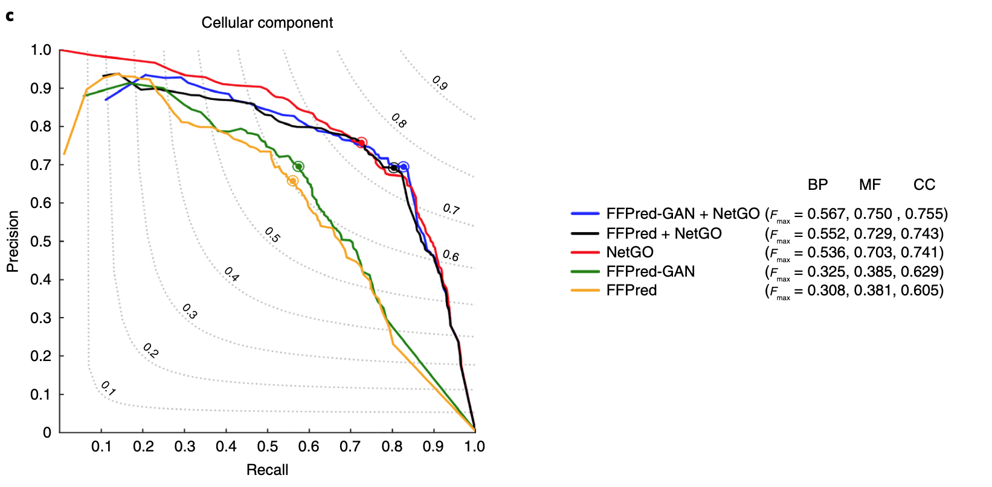
GANs Applications: Data Augmentation
Evaluation:

Slide 27
Bibliography and other resources:
Papers:
A Comprehensive Survey and Analisis of Generative models in machine learning. https://www.sciencedirect.com/science/article/abs/pii/S1574013720303853
Generative Moment Matching Networks. https://arxiv.org/pdf/1502.02761.pdf
Generative Adversarial Nets. https://proceedings.neurips.cc/paper/2014/file/5ca3e9b122f61f8f06494c97b1afccf3-Paper.pdf
StackGan: text to Photo-realistics Image Synthesis with Stacked Generative Adversarial Networks. https://arxiv.org/pdf/1612.03242.pdf
Protein Function Prediction is improved by creating synthetic feature samples with GANs. https://www.nature.com/articles/s42256-020-0222-1

Slide 28
Bibliography and other resources:
Articles and others:
Understanding Generative Adversarial Networks. https://towardsdatascience.com/understanding-generative-adversarial-networks-gans-cd6e4651a29
Generating Synthetic Images from text. https://towardsdatascience.com/generating-synthetic-images-from-textual-description-using-gans-e5963bae0df4
StackGan Implementation. https://www.youtube.com/watch?v=ye6pYwBQQL4
Intro to Deep Learning #16. https://www.youtube.com/watch?v=gmvRStL_Dag

